Slide 1
Interactive Visualization of Large-scale Movement Data using Apache Spark
Junjun Yin
Social Science Research Institute
Pennsylvania State University, university park, PA, 16801

Slide 2
Outline
Big Movement Data
CyberGIS
Distributed computing environment in ROGER
Apache Hadoop
Apache Spark
Big Data processing in Hadoop Distributed File System (HDFS)
Pig script, MapReduce in Hadoop (Java) and Spark in Hadoop (Python)
Interactive data visualization with D3.js
Spark for data processing (Python) and D3 for visualization (JavaScript)
Hands on tutorials throughout the sessions

Slide 3
Outline – detailed I
Big Movement Data
Location Based Social Media Data (e.g. geo-located Tweets)
New York taxi data
Knowledge discover from movement datasets (e.g. movement flows and hot spots)
CyberGIS
Getting to know CyberGIS
ROGER
Distributed computing environment for Big Data processing
Introduction to Hadoop
MapReduce computing paradigm
Mapper, Reducer and combiner
HDFS (Hands on with data input and output)

Slide 4
Outline – detailed II
Introduction to Spark
What is Spark, why and when to use Spark
Comparisons between Spark and Hadoop
Spark basics (Hands on with interactive shell environment and simple Python script)
Visualization of density map of movement data
Density map generation for New York taxi GPS datasets
Implementation in Hadoop
Implementation in Spark ( based on space-time query)
Visualization of movement flows from Twitter data
Workflow design
Data preparation
Mapping movement flows in real geographical space (e.g. using polygons in shapefile)
Summarizing the origin and destination networks
Interactive visualization using D3.js

Slide 5
Big Movement Data
In today’s Big Data era, the advancement of positioning technology (e.g. GPS unit) enriches the data with spatial dimensions
Internet of Things
Various types of sensors recording all activities with geo-tags and timestamps
Continuously
Why spatial is special
Geo-located Twitter data (for Twitter user movements)
New York taxi data (for taxi movements)
Challenges
e.g., large volume, messy, noisy
Can traditional GIS (geographical information system) work? (maybe?)
The need for cyberGIS for efficient data management and processing
Notes:
Over 2 million tweets (2 GB) collected for North American per day
400 million for half a year
That is just 1% of all the tweets!
For New York taxi data, basically, Chris has to send several hard drives to the collect the data and it is only for one year already processed data

Slide 6

Visualization and knowledge discovery
Visualization of New York taxi data
The black pixel means the taxi did not have fare and yellows means it did
Source: http://chriswhong.com/open-data/my-first-data-art-nyc-taxi-defrag/
Notes:
Each row represents one taxi, each pixel is one minute and 60 minutes, 12 hours a day.

Slide 7
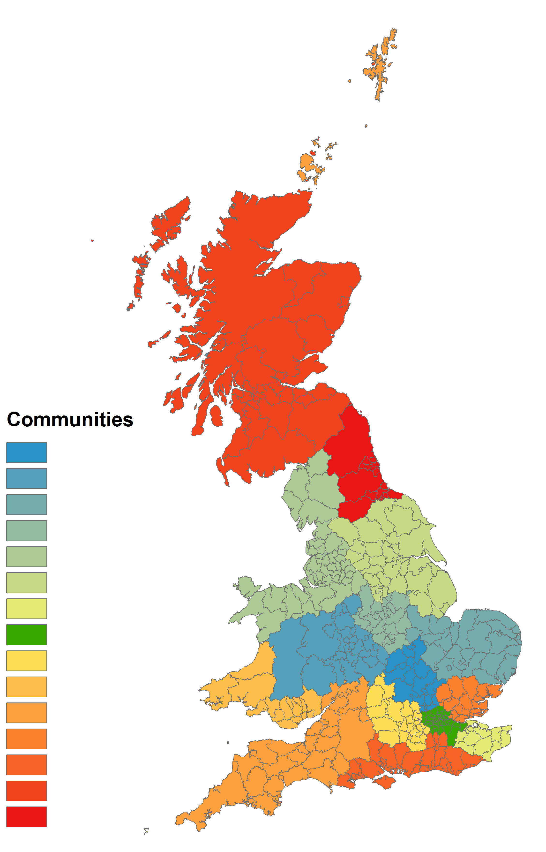
Visualization and knowledge discovery
Source: X Liu, L Gong, Y Gong, Y Liu - Journal of Transport Geography, 2015
Community structure of the Great Britain based on the movement of Twitter users

Slide 8
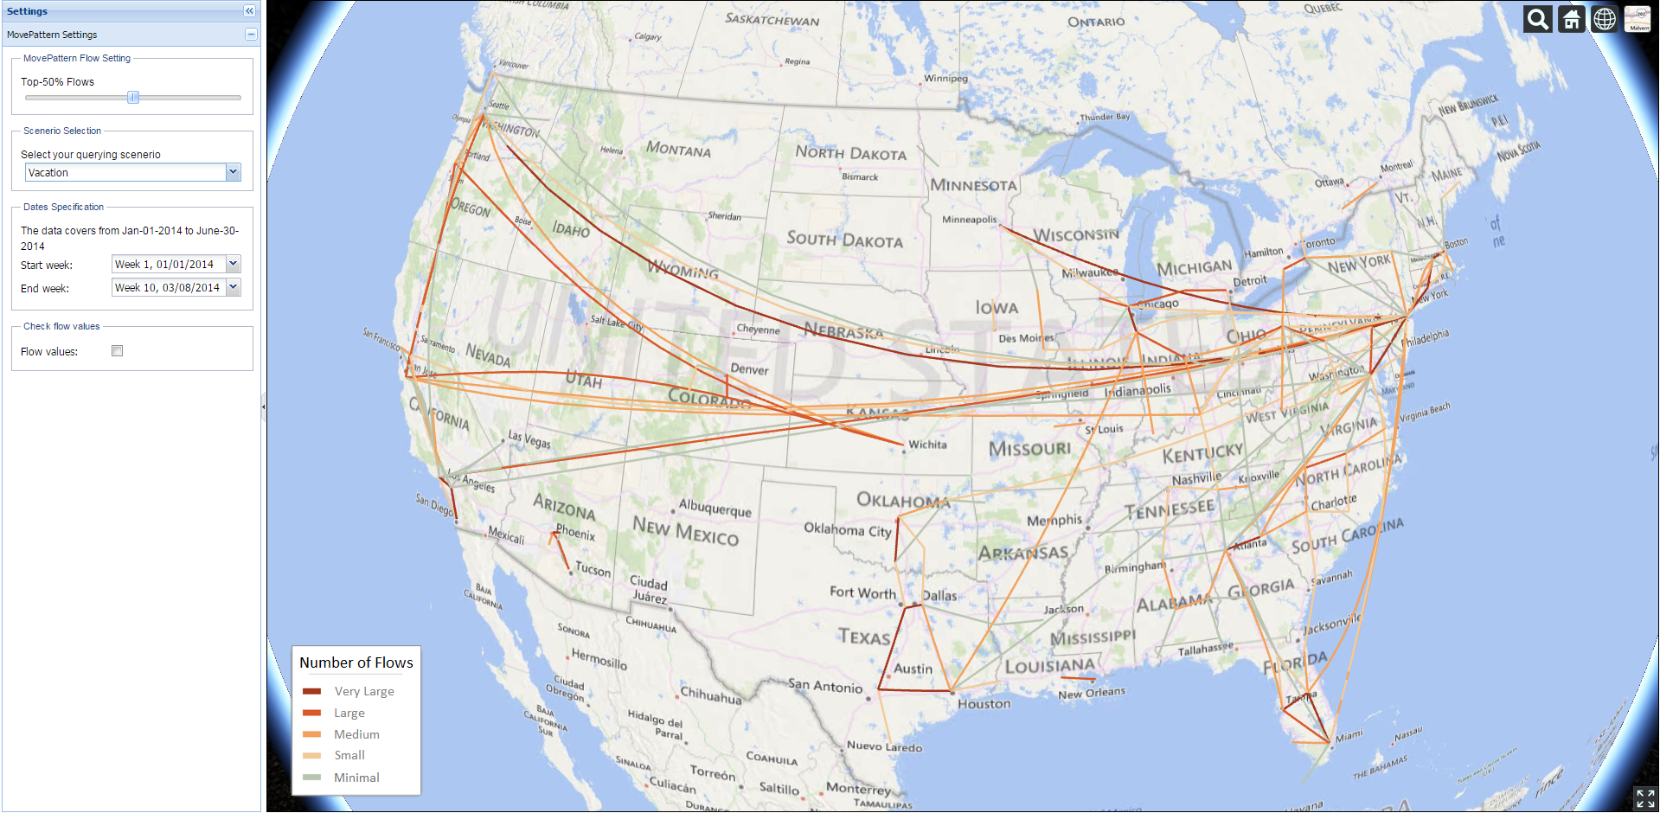
MovePattern
Key-word specified (scenario-based) Twitter user movement patterns
Adjustable (longer) time range selection
Utilizing MapReduce approach with Apache Hadoop for larger volume of data processing
3D virtual globe visualization

Slide 9

CyberGIS
CyberGIS is Geographic Information Science and Systems based on advanced cyberinfrastructure.
Why CyberGIS?
Geospatial discovery and innovation with advanced digital technologies¹
Big data
Big compute
CyberGIS
Big collaboration
Big problems
1. Wang, S. (2013) “CyberGIS: Blueprint for Integrated and Scalable Geospatial Software Ecosystems.” International Journal of Geographical Information Science, 27 (11): 2119-2121
Notes:
CyberGIS more focuses on Spatial thinking.
These advanced technologies not only bring forth computational
innovation such as geospatial optimization and simulation, but also
yield actionable insight from big data. GIScience therefore seeks today to resolve
problems of dealing with and analyzing heterogeneous spatial data, integrating
and synthesizing diverse data sources, and orchestrating collaboration, rather
than data collection and pre-processing.

Slide 10

ROGER
CyberGIS ROGER
Resourcing Open Geospatial Education and Research
After Roger Tomlinson
~60 TFlop/s
Notes:
Roger Tomlinson has been called the “Father of GIS” thanks to his leadership of the Canada Geographic Information System, the first computerized GIS.
The Tflops number for ROGER is theoretical, it has not been benchmarked yet. It is undergoing testing now, and should be fully open for use before fall semester. For more information, contact Johnathan (jfr@Illinois)

Slide 11
ROGER
Hadoop cluster
cg-hm03 ~ cg-hm07 + cg-hm13 ~ cg-hm16 (9 nodes in total)
name node: cg-hm03
hdfs://cg-hm03.ncsa.illinois.edu/user/cgtrnXX/
login node: cg-hm06
ssh cgtrnXX@roger-login.ncsa.illinois.edu
ssh cg-hm06
Hadoop cluster for Spark
cg-hm11, cg-hm12, cg-hm17, cg-hm18
name node: cg-hm11
hdfs://cg-hm03.ncsa.illinois.edu/user/cgtrnXX/
login node: cg-hm18
ssh cgtrnXX@roger-login.ncsa.illinois.edu
ssh cg-hm18
Notes:
mention the powerfulness of ROGER

Slide 12
Set up guide – Before we start
Objective: Install the necessary software, and login to ROGER for this workshop.
Perform the following steps prior to the start of the course:
Step 1: Login to the ROGER cluster with a SSH client.
$ ssh cgtrnXX@roger-login.ncsa.illinois.edu
Host Name: roger-login.ncsa.illinois.edu
ID/Password: cgtrxXX/*****
Download MobaXterm for Windows if you don’t have a SSH client (http://go.Illinois.edu/mobaxterm - just unzip and run, no install)
Use Terminal for Mac and Linux users
Step 2: Use users unix command to list usernames currently logged in.
~cgtrnxx$ users

Slide 13
Set up guide – Before we start
Step 3: Login to the Hadoop cluster and run a smoke test.
~cgtrnxx$ ssh cg-hm06 (note that access to cg-hm06 is via roger-login)
~cgtrnxx$ hadoop version (see Hadoop version: Hadoop 2.6.0.2.2.0.0-2041)
~cgtrnxx$ yarn node -list (see 9 Datanodes available in the cluster)
You can do the same on Hadoop cluster for spark
you need to first exit cg-hm06: ~cgtrnxx@cg-hm06$ exit
Step 4: Copy files and directories for this course’s exercises and demos.
~cgtrnxx$ mkdir your_name (whichever you like)
~cgtrnxx$ cp -r /projects/EOT/spark ~/your_name
~cgtrnxx$ cd ~/your_name/spark (change directory)
~cgtrnxx$ ls (list all files in your current directory)
You should now have logged in and been ready to start this course.
If any of these steps failed, please let us know.

Slide 14
Distributed Computing using Hadoop
What is Hadoop
Distributed file system + replicating data in multiple nodes.
Easy-to-use MapReduce interface.
Scalable.
Parallel execution of mappers/reducers.
Fault tolerant.
When to use Hadoop
Data is too big to fit into memory.
Tasks can be decomposed as batch-based processing.
The problem can be modeled by MapReduce computing paradigm.
Scalability is the major issue not interactivity.

Slide 15
Distributed Computing using Spark
What is Spark
An open-source cluster computing framework originally developed in the AMPLab at UC Berkeley
The fundamental programming abstraction is Resilient Distributed Datasets (RDD), which is a logical collection of data partitioned across machines.
Run programs up to 100x faster than Hadoop MapReduce in memory, or 10x faster on disk.
Ease of Use
Write applications quickly in Java, Scala, Python, R.
Runs Everywhere
Spark runs on Hadoop, Mesos, standalone, or in the cloud. It can access diverse data sources including HDFS, Cassandra, HBase, and S3.
When to use Spark
When the operations involves iterations, especially machine learning and data mining algorithms
Repeatable/multiple queries on the same large dataset

Slide 16
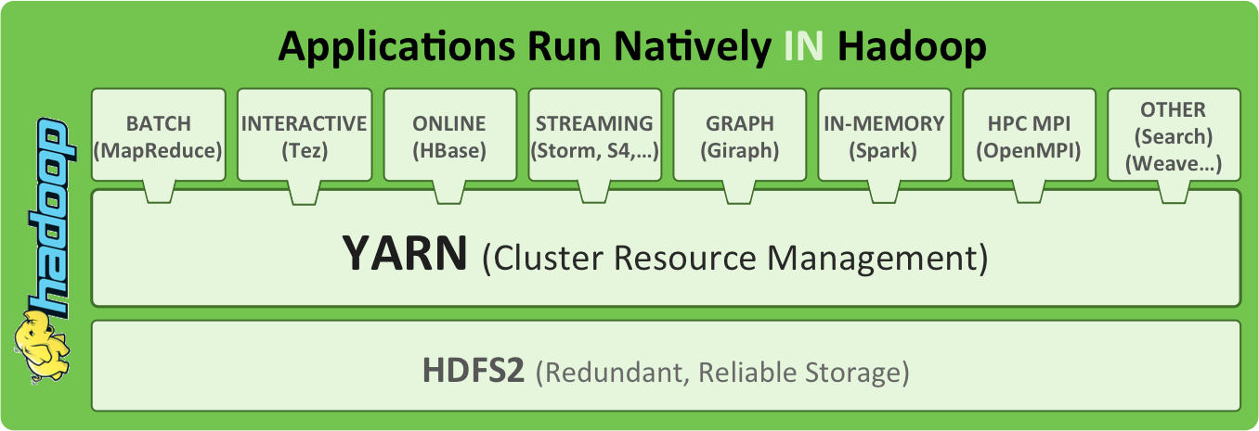
Hadoop Architecture
Source: http://radar.oreilly.com/2014/01/an-introduction-to-hadoop-2-0-understanding-the-new-data-operating-system.html
Notes:
Yahoo developed HDFS to compete with GFS (Google). Google developed MapReduce for their own system.
Yarn for resource management. Queue system.
Hbase – big table, column based database. OS version. SQL-like.
Hive for Hbase
Pig for raw data like loaded CSVs

Slide 17
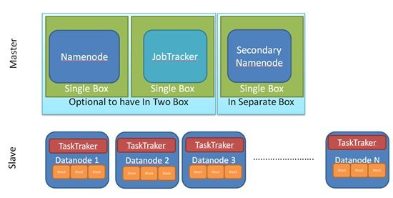
Terminologies
Notes:
The NameNode is the centerpiece of an HDFS file system. It keeps the directory tree of all files in the file system, and tracks where across the cluster the file data is kept. It does not store the data of these files itself.
Optional SecondaryNameNode that can be hosted on a separate machine.

Slide 18
Terminologies
NameNode
manages the file system metadata for HDFS
DataNode
store the actual data
JobTracker
responsible for scheduling the jobs' component tasks on the TaskTrackers, monitoring them and re-executing the failed tasks
TaskTracker
execute the tasks as directed by the JobTracker
NameNode and JobTracker are the masters

Slide 19
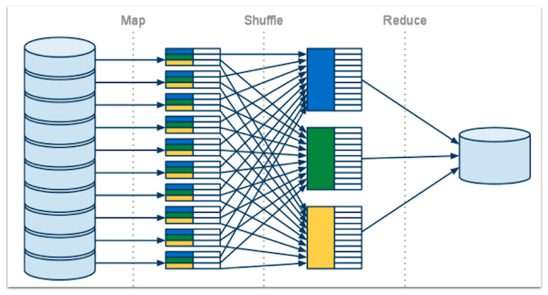
MapReduce computing paradigm
Notes:
Map: filtering and sorting
Reduce: summary

Slide 20
Example: Find word count in a corpus
Find the frequency of words in a text corpus.
Input: Bag of words =>
“Research”, “Student”, “GIS”, “CIGI”, “Student”, “Geospatial”, “Research”, “Center”, “GIS”, “Research”, “CIGI”, “Research”, “Geospatial”, “GIS”
Output – <Word, Frequency>
Research | 4
Student | 2
CIGI | 2
Center | 1
GIS | 3
Geospatial | 2

Slide 21
Mapper
Key | Value
Research | 1
Student | 1
GIS | 1
CIGI | 1
Student | 1
Geospatial | 1
Research | 1
Research
Student
GIS
CIGI
Student
Geospatial
Research
Mapper
1
Key | Value
Center | 1
GIS | 1
Research | 1
CIGI | 1
Research | 1
Geospatial | 1
GIS | 1
Center
GIS
Research
CIGI
Research
Geospatial
GIS
Mapper
2
Notes:
Point weights as an option, applying values, perhaps by category or spatial bounding box.

Slide 22
Shuffle
CIGI | 1
CIGI | 1
Key | Value
Research | 1
Student | 1
GIS | 1
CIGI | 1
Student | 1
Geospatial | 1
Research | 1
Geospatial | 1
Geospatial | 1
GIS | 1
GIS | 1
GIS | 1
Research | 1
Research | 1
Research | 1
Research | 1
Key | Value
Center | 1
GIS | 1
Research | 1
CIGI | 1
Research | 1
Geospatial | 1
GIS | 1
Student | 1
Student | 1
Center | 1

Slide 23
Reducer
Key | Value
CIGI | 2
CIGI | 1
CIGI | 1
Geospatial | 1
Geospatial | 1
Key | Value
Geospatial | 2
GIS | 1
GIS | 1
GIS | 1
Key | Value
GIS | 3
Research | 1
Research | 1
Research | 1
Research | 1
Key | Value
Research | 4
Key | Value
Student | 2
Student | 1
Student | 1
Key | Value
Center | 1
Center | 1
Notes:
Summary.

Slide 24
Combiner
Key | Value
Research | 1
Student | 1
GIS | 1
CIGI | 1
Student | 1
Geospatial | 1
Research | 1
Key | Value
Research | 2
Student | 2
GIS | 1
CIGI | 1
Geospatial | 1
Mapper
Output
Key | Value
Center | 1
GIS | 1
Research | 1
CIGI | 1
Research | 1
Geospatial | 1
GIS | 1
Key | Value
Center | 1
GIS | 2
Research | 2
CIGI | 1
Geospatial | 1
Notes:
Run in the memory of the mapper.

Slide 25
Reducer + Combiner
Key | Value
CIGI | 2
CIGI | 1
CIGI | 1
Geospatial | 1
Geospatial | 1
Key | Value
Geospatial | 2
GIS | 1
GIS | 2
Key | Value
GIS | 3
Research | 2
Research | 2
Key | Value
Research | 4
Key | Value
Student | 2
Student | 2
Key | Value
Center | 1
Center | 1

Slide 26
Example in Spark
change to the working directory: cd ~/cgtrnxx/your_name/spark/data
launch spark:
ssh cg-hm18
module load java
pyspark
text_file = sc.textFile("words.txt")
counts = text_file.flatMap(lambda line: line.split(",")).map(lambda word: (word, 1)).reduceByKey(lambda a, b: a + b)
#counts.saveAsTextFile("hdfs://...") (this saves to HDFS format, we will not use it this time)
results = counts.collect()
print results
type exit() to exit Spark shell

Slide 27
Basic Spark syntax
pyspark script.py
spark-submit script.py
spark-submit --master yarn-cluster --executor-memory 20G --num-executors 50 script.py
Important notes about spark-submit with YARN
Set the parameters within the code
import pyspark
from pyspark.context import SparkContext
from pyspark import SparkConf, SparkContext
from pyspark.storagelevel import StorageLevel
conf = (SparkConf().setMaster("yarn-client").setAppName("flow_generator").set("spark.executor.memory", "4g").set("spark.executor.instances", 50))
sc = SparkContext(conf = conf)
Run the script using spark-submit script.py

Slide 28


Hands-on

Slide 29
Hadoop and Spark hands-on!
Create a density map from large-volume of point-based data (e.g. New York taxi GPS tracking data)
Use both Hadoop and Spark implementations
Repeatable and interactive space-time query in Spark

Slide 30
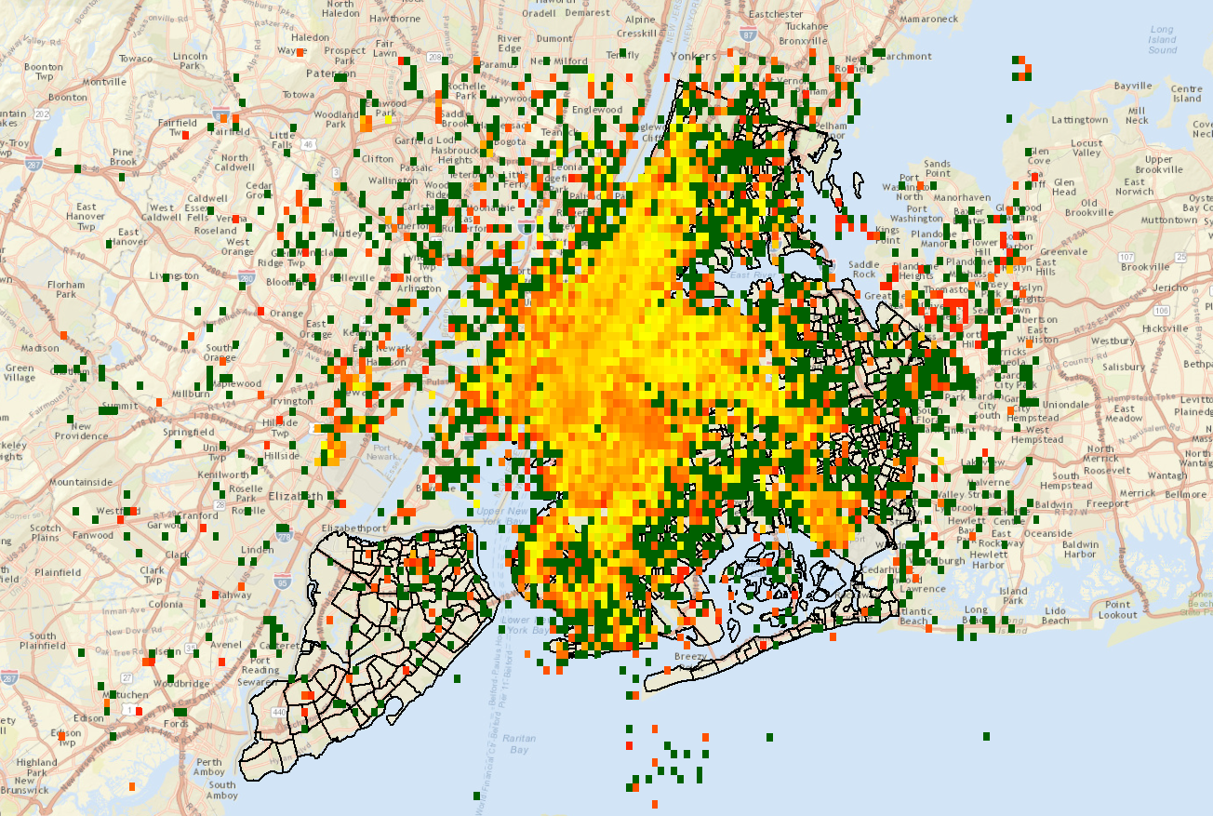
New York taxi pickup passenger density map

Slide 31
How to do it?
Partition the study area into regular grids
For each record entry, find the cell it falls in
Summarize the sum and the count of radiation values in each cell
Calculate the averaged value in each cell
Output a raster

Slide 32
Taxi Data
January 2013 Taxi Trips from FOIA (Freedom of Information Act) request from Chris Whong
(http://www.andresmh.com/nyctaxitrips/)
Trip:
medallion, hack_license, vendor_id, rate_code, store_and_fwd_flag, pickup_datetime, dropoff_datetime, passenger_count, trip_time_in_secs, trip_distance, pickup_longitude, pickup_latitude, dropoff_longitude, dropoff_latitude Fare:
medallion, hack_license, vendor_id, pickup_datetime, payment_type, fare_amount,surcharge, mta_tax, tip_amount, tolls_amount, total_amount
Notes:
Explain code

Slide 33
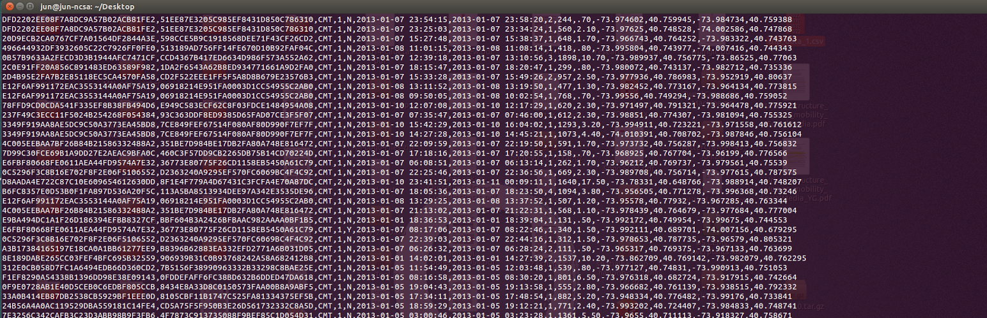
What does data look like?
If you want to check the contents of the taxi data in the terminal, the following command will print the first two lines, replacing the commas with two spaces to make it easier to read:
head -n 2 trip_data_1.csv | sed 's/,/ /g‘
or: tail trip_data_1.csv

Slide 34
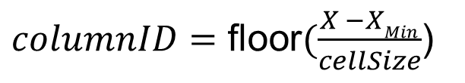
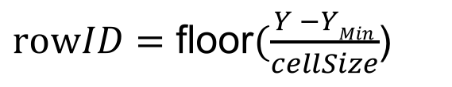
Find the cell number (index) that a point belongs to:
(X_{Min}, Y_{Max})
(xMax, Y_{Max})
[6,0]
[5,0]
[4,0]
[3,0]
[2,0] | [2,1] | [2,2]
[1,0] | [1,1] | [1,2]
[0,0] | [0,1] | [0,2] | [0,3] | [0,4] | [0,5]
$columnID=\text{floor}(\frac{X −XMin}{cellSize}$)
$rowID=\text{floor}(\frac{Y −YMin}{cellSize}$)
(X_{Min}, Y_{Min})
(X_{Max}, Y_{Min})

Slide 35
Hadoop hands-on!
Steps
Login to cg-hm06
ssh cgtrnxx@roger-login.ncsa.Illinois.edu
ssh cg-hm06
hdfs dfs –mkdir your_name
Copy the New York taxi to HDFS
cd /home/cgtrnxx/your_name/spark/data
(note that /home/cgtrnxx is equivalent to ~)
hdfs dfs –copyFromLocal trip_data_1.csv your_name/
Compile the code
cd ~/your_name/spark/NY_Taxi_Raster

Slide 36
Compile the code
Use Apache Ant to compile the code.
Define dependencies.
Automatic make process.
build.xml file define the compile process (pay attention to the items in the build.xml).
cd ~/your_name/spark/NY_Taxi_Raster
/home/cgtrnxx/your_name/spark/ant/bin/ant clean compile jar

Slide 37
Run the code
hadoop jar dist/queryNYTaxi.jar classes/runhadoop/RunRadQuery.class your_name/trip_data_1.csv your_name/processed.csv taxiImage_yourname.asc 40.479636 40.930724 -74.402322 -73.630027 0.005

Slide 38
Make a Map!
Output describes average taxi occupancy per cell
Download results
Use nano to view the result: nano taxiImage_yourname.asc
Download the data to your local machine:
scp cgtrnxx@roger-login.ncsa.Illinois.edu:~/your_name/spark/NY_Taxi_Raster/taxiImage_yourname.asc ./ (your local directory)
or simply use MobaXterm to drag and drop to your local directory
Visualize in ArcMap
set data frame projection to WGS84, add base map, add .asc file
Change fields used in taxi data and try again
change lines 61 and 76 in QueryMapper.java ( vim src/mapper/QueryMapper.java)
ant clean compile jar
remove intermediate file from HDFS: hdfs dfs –rmr your_name/processed.csv
remove previous output grid from linux: rm taxiImage.asc

Slide 39
View the result image using Firefox
In the result folder, run ./plotTaxi , it will generate a png file named as taxi.png
Open a new top to login to ROGER with X server capability
ssh –X cgtrnxx@roger-login.ncsa.illinois.edu
/home/cgtrnxx/your_name/spark/firefox/firefox –no-remote
open the image file
by pasting the following link in the browser
file:///home/cgtrnxx/your_name/spark/NY_Taxi_Raster/taxi.png
or by open file window in the browser

Slide 40
Spark hands-on!
The same implementation in Spark
Import the trip_data_1.csv into Hadoop cluster for Spark
exit cg-hm06: exit
ssh cgtrnxx@roger-login.ncsa.illinois.edu
Password cyberSS15
ssh cg-hm18
cd /home/cgtrnxx/your_name/spark/data
hdfs dfs -mkdir your_name
hdfs dfs –copyFromLocal trip_data_1.csv your_name/

Slide 41
Run the code
Locate the Spark script
cd ~/your_name/spark/code/python
Edit the script to locate the taxi data
vim spark_taxiQuery.py
show line number. :set nu
go to line 101, change
dataset = sc.textFile('hdfs://cg-hm11.ncsa.illinois.edu/user/cgtrnXX/your_name/trip_data_1.csv').filter(lambda x: True).cache()
save and quit. :wq
Run the code
module load anaconda
spark-submit --num-executors 18 --executor-cores 2 --executor-memory 4g spark_taxiQuery.py 2013-01-01 2013-02-01 40.479636 40.930724 -74.402322 -73.630027 0.005 0.005

Slide 42
Spark hands-on 2!
Repeatable space-time query in Spark
Locate the Spark script
cd ~/your_name/spark/code/python
Edit the script to locate the taxi data
vim spark_taxiQuery_interactive.py
show line number. :set nu
Pay attention to line 8 (the port number),
go to line 101, change to:
result.saveAsTextFile('hdfs://cg- hm11.ncsa.illinois.edu/user/cgtrnXX/your_name/taxi_raster_%s.txt' %str(time.time()))
save and quit. :wq

Slide 43
Run the code
You will need to have two consoles (open a new tab in MobaXterm)
login to cg-hm18 at the same time
ssh cgtrnxx@roger-login.ncsa.Illinois.edu
ssh cg-hm18
In one of the consoles, run:
pyspark spark_taxiQuery_interactive.py --num-executors 18 --executor-cores 2 --executor-memory 4g
In the other console, run:
nc localhost 7748 (this is the port number)
2013-01-01 2013-02-01 40.479636 40.930724 -74.402322 -73.630027 0.005 0.005
change to different dates (in January) and run (or different latitude and longitude)

Slide 44
Review the code for details
Examine the Hadoop code:
cd ~/your_name/spark/NY_Taxi_Raster
code in src/mapper src/reducer src/runhadoop
use vim to view the code
Examine the Spark code:
cd cd ~/your_name/spark/code/python
vim spark_taxiQuery.py
vim spark_taxiQuery_interactive.py

Slide 45

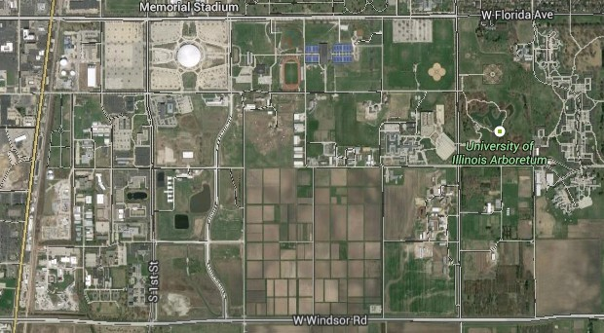

Visualizing Twitter user movements
Movement 1
Movement 2
Mapping units
45

Slide 46
An example geo-located Twitter message
“user_id”Some little bug has bitten me in the night and my knee is the size of a melon at present.. Not the best of starts to my day! #antihystermine51.3432617,1.4025932<a href="http://twitter.com/download/android" rel="nofollow">Twitter for Android</a>false1Tue Jul 01 23:40:46 CDT 2014-1en166145388http://abs.twimg.com/images/themes/theme10/bg.gifLe5leyH25b176c519f167e6BroadstairsBroadstairsUnited Kingdomneighborhoodnull(51.326601,1.3832097),(51.377546,1.3832097),(51.377546,1.449228),(51.326601,1.449228),Polygonhttps://api.twitter.com/1.1/geo/id/25b176c519f167e6.jsonLesley HopperRamsgate. Kent. England2082203759Tue Jul 13 07:55:49 CDT 2010
User_ID, latitude1, longitude1, timestamp1
User_ID, latitude2, longitude2, timestamp2
Trajectory: User_ID, <location1, timestamp1>, <location 2, timestamp2>, …

Slide 47
Illustrations of mapping movements in different units
(a) Polygon based mapping units (ward level) (b) Grid based mapping units (10 km)

Slide 48
Preparing the data using Pig
PIG is a higher level, SQL-like programming language for Hadoop jobs.
Easier code for simple (and even some advanced) Hadoop jobs.
On a compute cluster, it will be around the same speed as the Java MapReduce code
In this workshop, we will only use one day data (1st February, 2014)
ssh cgtrnxx@roger-login.ncsa.Illinois.edu
ssh cg-hm06
cd ~/your_name/spark/data/twitter/day1.txt
hdfs dfs –copyFromLocal day1.txt your_name/
The Pig script is located in:
cd ~/your_name/spark/code/pig
pig -f filter_usa.pig -param input=your_name/day1.txt

Slide 49
Pig script
raw = LOAD '${IN_DIR}${input}' USING PigStorage('\u0001') AS (tweetId,text:chararray,geo,source,isretweet,search_id,create_at,meta_data,to_user_id,language_code,user_id,profile_image_url,user_name,place_id,place_name,place_fullname,country,place_type,street_address,boundary,boundary_type,place_url);
clean = DISTINCT raw;
step0 = FILTER clean BY geo is not null AND geo != 'null' AND geo != '' AND isretweet == 'false' AND create_at is not null AND create_at != 'null' AND create_at != '';
step1 = FOREACH step0 GENERATE user_id, flatten(STRSPLIT(geo, ',')), To_ISO(Get_Time(REPLACE(REPLACE(create_at, 'CDT', '-05:00'), 'CST', '-06:00'), 'EEE MMM dd HH:mm:ss Z yyyy')) , text;
-- $2 is longitude, $1 is latitude
step2 = FILTER step1 BY $2 > -167.276413 AND $2 < -56.347517 AND $1 > 5.499550 AND $1 < 82.296478;
step3 = FOREACH step2 GENERATE $0, $1, $2, $3;
STORE step3 INTO '${OUT_DIR}${input}_usa.txt' USING PigStorage(',');

Slide 50
Preparing the data using Pig
Run Pig script:
cd ~/your_name/spark/code/pig
pig -f filter_usa.pig -param input=your_name/day1.txt
Collect the data:
hdfs dfs –getmerge your_name/day1.txt_usa.txt day1_usa.txt (this is the file to be saved in your local directory)
view the data:
tail day1_usa.txt
or head -100 day1_usa.txt

Slide 51
Determine point-in-polygon Spark with ESRI’s shapefile
To map Twitter user’s movement to a corresponding mapping unit, e.g. county, zip code area, state, etc., we need to perform “point-in-polygon” operation
Traditional spatial database provides such operation, however…!
For Spark, there is no spatial operation implemented nor does it recognize ESRI’s shapefile and GeoJSON format
The power of open source
For Python, there is Shapefile.py (https://github.com/GeospatialPython/pyshp)
Even Spark is open sourced
To deal with large number of polygons and improve search efficiency, we had a Quad-Tree implementation as well

Slide 52
Determine point-in-polygon
Copy the data to HDFS
cd ~/your_name/spark/data/twitter
hdfs dfs –copyFromLocal day1_usa.txt your_name/
Navigate to the source folder:
cd ~/your_name/spark/code/python
ls (list all the files in the folder)
Create a QuadTree for the shapefile (it is actually already there):
rm quadTree.txt
python buildTree.py us/us_states.shp quadTree.txt
Edit the script to specify the right input and output files
vim spark_pinP.py

Slide 53
Determine point-in-polygon
Perform the operations in Spark Shell environment
cd ~/your_name/spark/code/python
cp /projects/EOT/spark/code/python/shell_spark.txt ./
View the code: vim shell_spark.txt
Open a text editor of your choice in your local machine
Copy the text from vim to the text editor
Quit vim, :q
Let’s copy line by line and see what happens exactly!

Slide 54
Determine point-in-polygon in a script
Edit the script
show line numbers in vim. :set nu
change line 22 as:
('hdfs://cg-hm11.ncsa.illinois.edu/user/cgtrnXX/your_name/day1_usa.txt')
change line 45 as:
(‘hdfs://cg-hm11.ncsa.illinois.edu/user/cgtrnXX/your_name/day1_usa_polygon.txt’)
Run the script
spark-submit spark_pinP.py
Check the result
hdfs dfs –getmerge your_name/day1_usa_polygon.txt day1_usa_polygon.txt
vim day1_usa_polygon.txt

Slide 55
Determine point-in-polygon
Review the script
How do we add files when submitting the job via YARN
How do we specify the parameters
How do we performs the searches to find the candidate polygon
How do we specify the input and output
How do we implement the filter() and map() functions
…
What’s next?
Now we know each point belong to a certain polygon, and we know the timestamp for which is the origin and which is the destination
The next is mapping movement flows

Slide 56
D3.js
A JavaScript library for manipulating documents based on data.
D3 provides visualization of data using HTML, SVG, and CSS.
D3 combines powerful visualization components and a data-driven approach to DOM manipulation.
Everything you want to know about D3.js, visit http://d3js.org/
Check out the demos on the website
For geographical visualization: http://datamaps.github.io/

Slide 57
D3.js
Start a simple web server
cd ~/your_name/spark/mp_d3
python -m SimpleHTTPServer 80xx
(xx could be your account number, for those who use the same account, you could use 70xx if you see an error)
Open another console and login to ROGER with X server on
ssh -X cgtrnxx@roger-login.ncsa.illinois.edu
launch firefox: /home/cgtrnxx/your_name/spark/firefox/firefox --no-remote
open the link: http://localhost:80xx/index.html

Slide 58
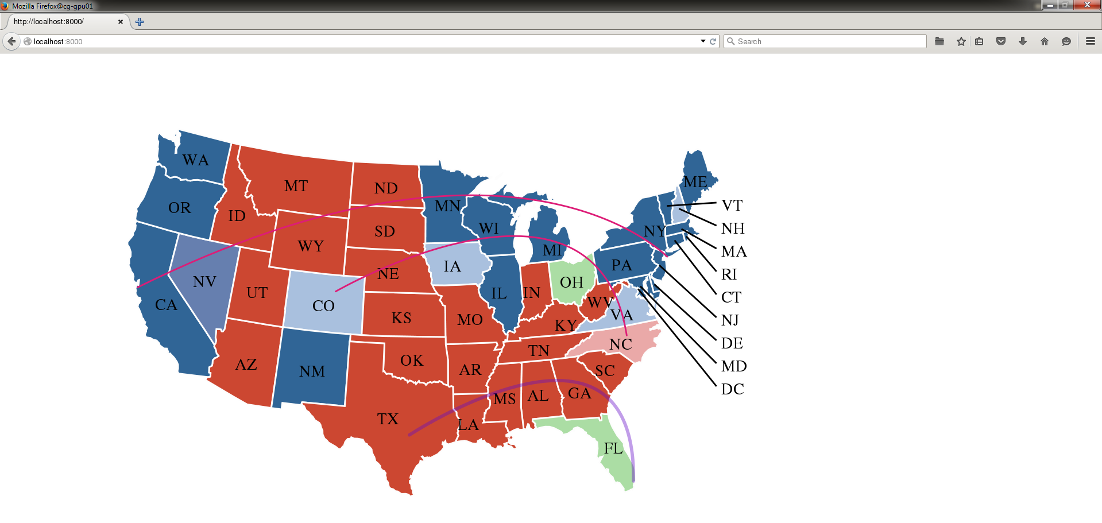
Demo: Map of USA

Slide 59
Create your own map
TopoJSON
https://github.com/mbostock/topojson
Usage:
topojson [options] -- [file …]
Input files can be one or more of:
.json GeoJSON or TopoJSON
.shp ESRI shapefile
.csv comma-separated values (CSV)
.tsv tab-separated values (TSV)

Slide 60
Generate Twitter user movement flows
For this workshop, let’s consider the state-level Twitter user movements
Suppose a user Twitter user tweeted at state A at time t1, and next moment, this user tweeted at state A at time t2, and next moment, at state B at time t3
Therefore, the flow from A to B is one
And imaging the collection of millions of Twitter users
A, B, count1
B, C, count2
…
M, N, countn

Slide 61
Generate Twitter user movement flows
Edit the script
cd ~/your_name/spark/code/python
vim spark_flows.py
Show line number. :set nu
Change line 25 to: mOutFile = open("/home/cgtrnxx/your_name/spark/us_d3/matrix.json","wb")
Change line 52 to: output.saveAsTextFile('hdfs://cg-hm11.ncsa.illinois.edu/user/cgtrnXX/your_name/flow.txt')
Run the script
Copy the data:
cd ~/your_name/spark/data/twitter
hdfs dfs –copyFromLocal usa_polygon_feb.txt your_name/
module unload anaconda
Spark-submit spark_flows.py

Slide 62
Chord diagram of Twitter user movement flows among states
Start a simple web server
cd ~/your_name/spark/us_d3
python -m SimpleHTTPServer 80xx
(xx could be your account number, for those who use the same account, you could use 70xx if you see an error)
Open another console and login to ROGER with X server on
ssh -X cgtrnxx@roger-login.ncsa.illinois.edu
launch firefox: /home/cgtrnxx/your_name/spark/firefox/firefox –no-remote
open the link: http://localhost:80xx/index4.html

Slide 63
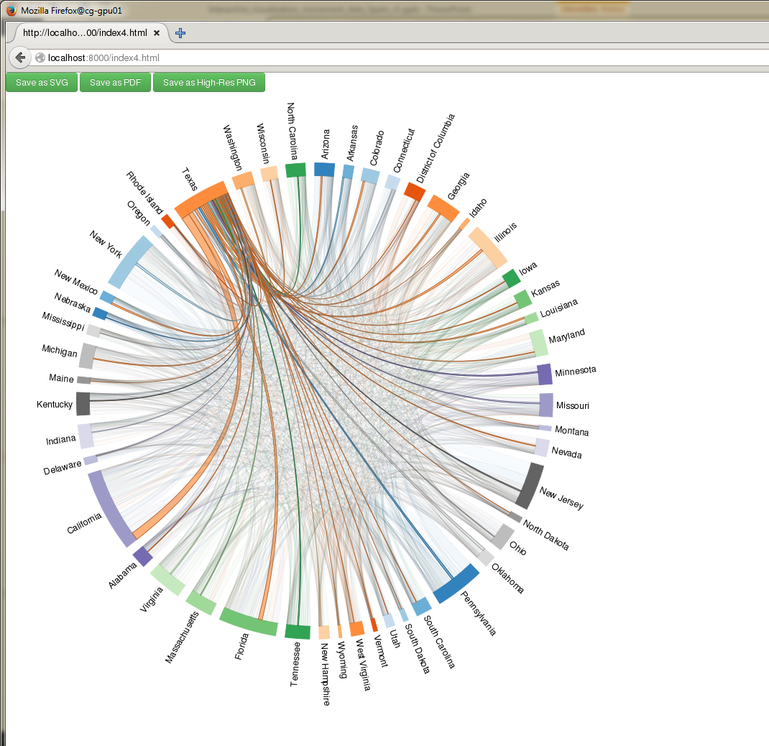
Chord diagram of Twitter user movement flows among states

Slide 64
Chord diagram of Twitter user movement flows among states
Review the code
vim index4.html
Check the code to identify where we loaded the flow matrix
Added double click to save SVG and PDF to local directory
Added hover over effects

Slide 65
Thanks!
Comments / Questions?
Junjun Yin: jyin@psu.edu

